Slide 1
Customer Retention Case Study Presentation
Prepared by HIRAL BALUJA

Slide 2

Agenda:
Introduction
Problem Statement
Objective
Exploratory Data Analysis (EDA)
Visualization
Inference
Interpretation of the Result
Future Work
Findings and Analysis
Assumptions
Conclusion

Slide 3
Introduction
What is Customer Retention and do we really need it?
“Customer retention refers to company’s ability to turn customers into repeat buyers and prevent them from switching to a competitor”
In other words customer retention means – “To maintain the existing customers”
This happens only if there exists a positive relation between the company and the customer.

Slide 4
What are the benefits of Customer Retention ?
Retained customers tend to buy other services from same company.
Retained customers are known to be less price/cost sensitive
The probability of selling to an existing customer is 60-70%
The probability of selling to new prospect is 5-20%
Declined migration rates
It’s more expensive to acquire a new customer than to retain an old one.

Slide 5
Tips for Succeeding at Customer Retention
Find out what customers want & what causes them to stay or leave ?
Proactively collect and promote customer feedback.
Analyze customer feedback to gain valuable insights and ensure the right people hear it.
Take action and Measure the results
Actively measure and monitor your customers’ loyalty and engagement
Keep asking, listening analyzing and improving

Slide 6
Motivation for the Problem Undertaken
Successful customer retention involves more than giving the customer what they expect.
Generating loyal advocates of the brand might mean exceeding customer expectations.
Creating customer loyalty puts 'customer value rather than maximizing profits and shareholder value at the center of business strategy’.
The key differentiation in a competitive environment is often the delivery of a consistently high standard of customer service.
Furthermore in the emerging world of Customer Success, retention is a major objective.

Slide 7
Problem Statement
Customer satisfaction has emerged as one of the most important factors that guarantee the success of online store; it has been posited as a key stimulant of purchase or repurchase intentions and customer loyalty.
A comprehensive review of the literature, theories and models have been carried out to propose the models for customer activation and customer retention.
Five major factors that contributed to the success of an e-commerce store have been identified as: service quality, system quality, information quality, trust and net benefit.
The research furthermore investigated the factors that influence the online customers repeat purchase intention.
The combination of both utilitarian value and hedonistic values are needed to affect the repeat purchase intention (loyalty) positively.
The data is collected from the Indian online shoppers. Results indicate the e-retail success factors, which are very much critical for customer satisfaction.

Slide 8
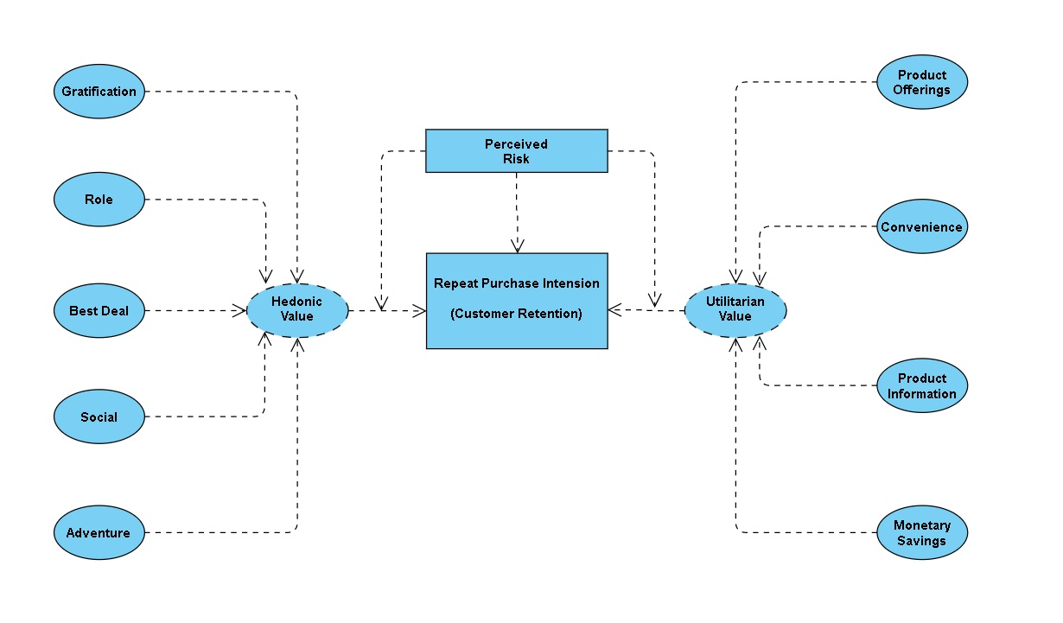
The problem statement can be represented in the form of below use case diagram as well.

Slide 9
Objective
The objective is to apply the analytical skills to provide findings and conclusion that would help to predict customer retention for a E-Retail company using their data on users provided over period of time.
Using the model I was tasked with determining which features were most influential in loss of valuable customer and then making a plan for how the company could use this information to increase customer retention.

Slide 10






Exploratory Data Analysis (EDA)
Requirements | Tools Used
Hardware | RAM: 8 GB or above Processor: Apple M1 Chip, Corei5 or above ROM/SSD: 256 GB or above
Software | Programming language : Python Distribution : Anaconda Navigator Browser based language shell : Jupyter Notebook
Libraries/Packages | Pandas NumPy matplotlib seaborn scikit-learn

Slide 11
Shape : 269 rows and 71 columns.
No null values present.
22% duplicate fields/records found.
Datatypes of all the columns are objects except for the “Pin Code" column which has integers.
First I have imported the necessary libraries and loaded the entire dataset in our Jupyter Notebook and renamed the columns.
Then I checked the shape of our dataset and found that we have a total of 269 rows and 71 different columns.
We don’t have any null values or missing values present in our dataset.
There is 22% percent of duplicate records in our dataset however I have chosen to retain those information instead of removing them.
By checking the data types I came to know that all the columns have ‘object’ data type except the column representing the Pin Code which has ‘integer’ data type.

Slide 12





Dataset Description
The top 5 Indian Online Retailers:
The data is collected from the Indian online shoppers. Our Dataset consists of reviews and feedbacks of customers on 5 top Indian Online Retailers : Amazon, Flipkart, Snapdeal, Myntra and Paytm.
Questionnaire is formed on the basis of brand strength, brand empathy or commitment, overall customer satisfaction and perceived value for money with intention to recommend.
Results indicate the e-retail success factors which are very much critical for customer satisfaction and retention.

Slide 13
Visualization
What is Data Visualization? Data visualization is defined as a graphical representation that contains the information and the data.
Benefits of Good Data Visualization? Data visualization is another technique of visual art that grabs our interest and keeps our main focus on the message captured with the help of eyes.
Different Types of Analysis for Data Visualization are Univariate Analysis: In the univariate analysis, we will be using a single feature to analyze almost all of its properties.
Bivariate Analysis: When we compare the data between exactly 2 features then it is known as bivariate analysis. Multivariate Analysis: In the multivariate analysis, we will be comparing more than 2 variables.
I have performed both univariate and bivariate analysis to visualize the data. In univariate analysis I have used pie plots, count plots and distribution plot and in bivariate analysis I have used count plot, factor plot and boxplots. Here I will be showing only bivariate analysis plots to analyze the data.

Slide 14
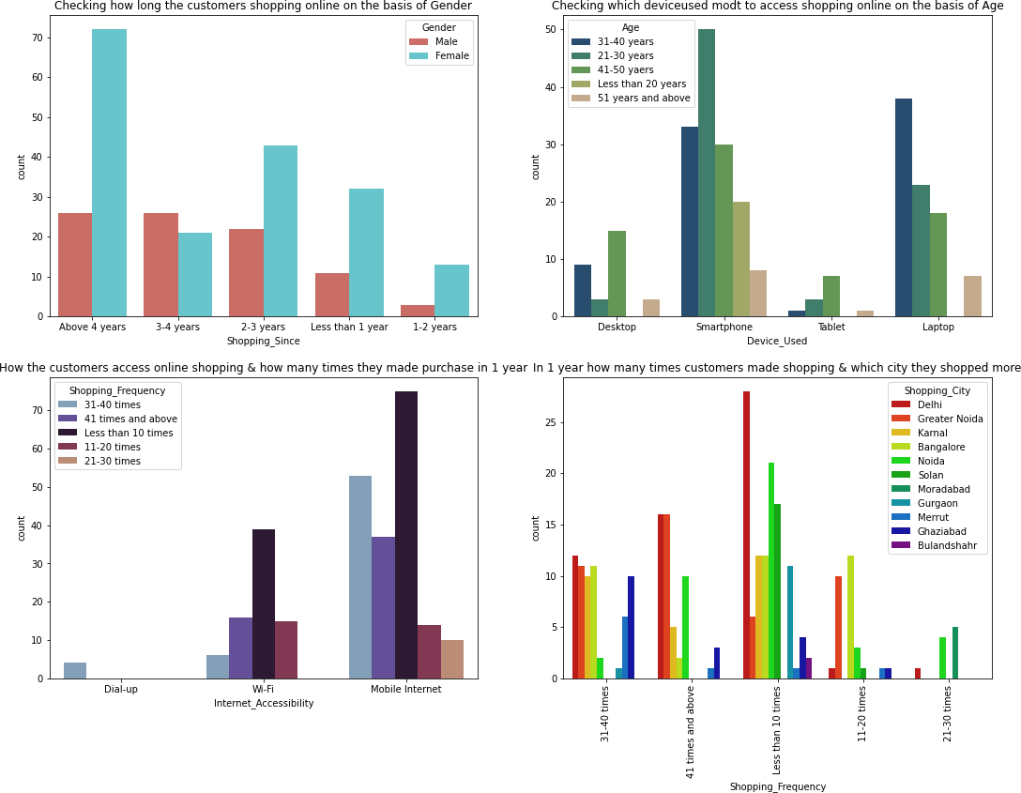

Slide 15
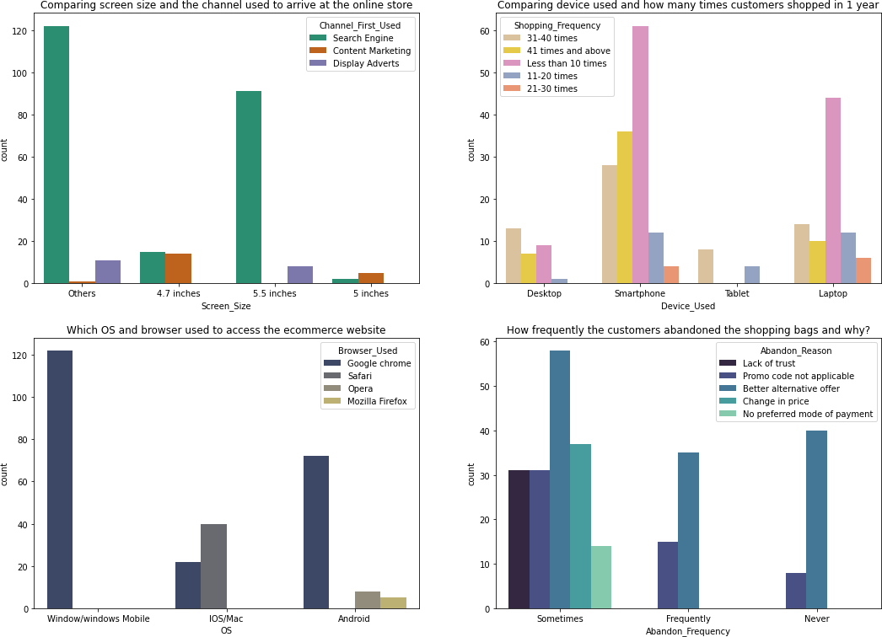

Slide 16
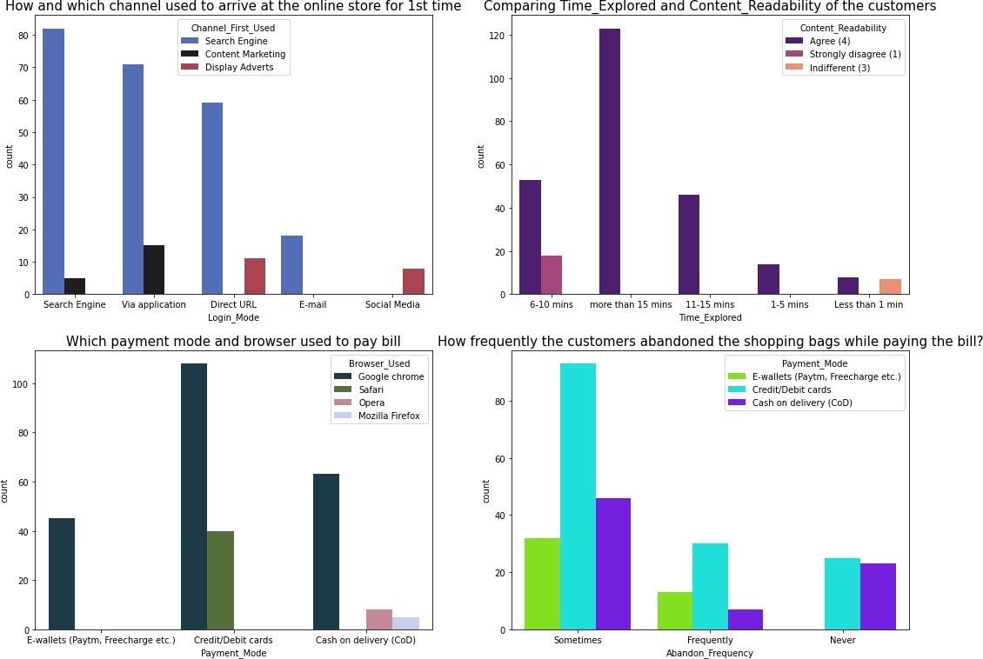

Slide 17
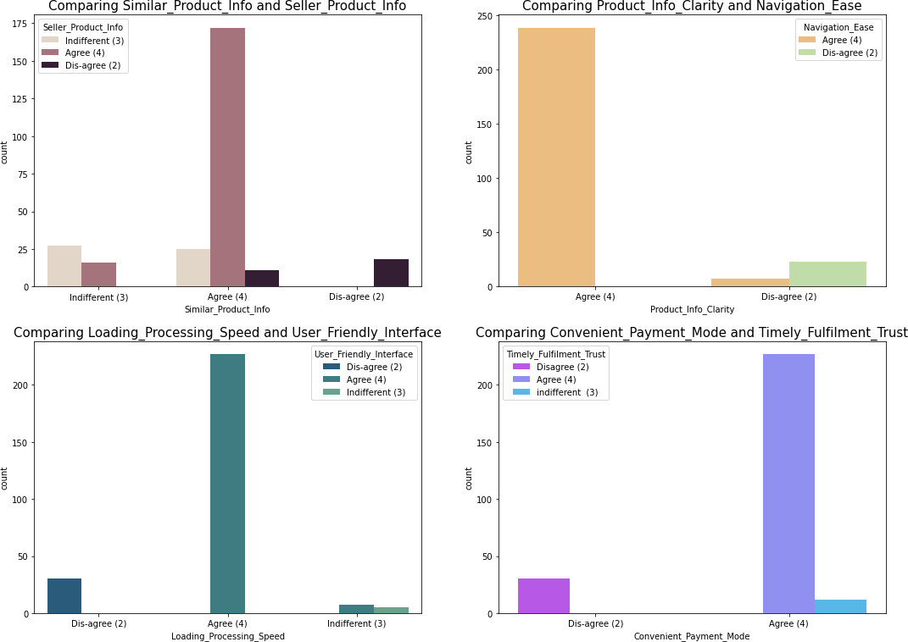

Slide 18
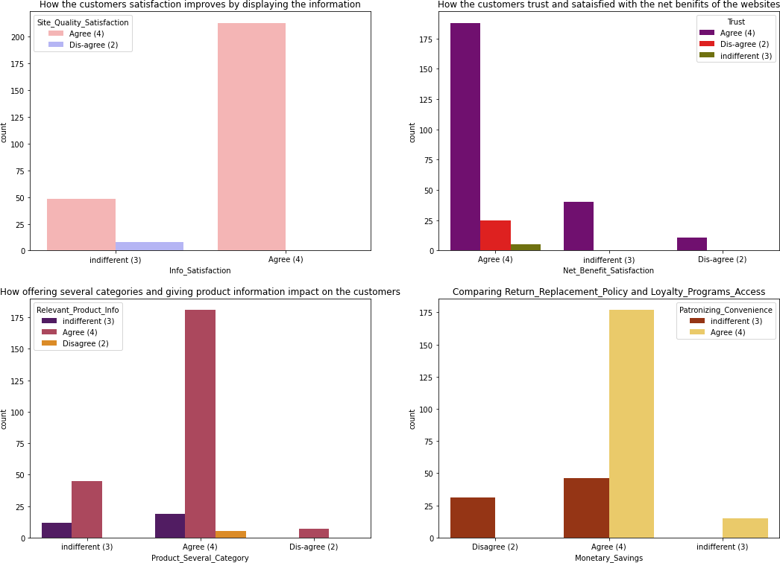

Slide 19
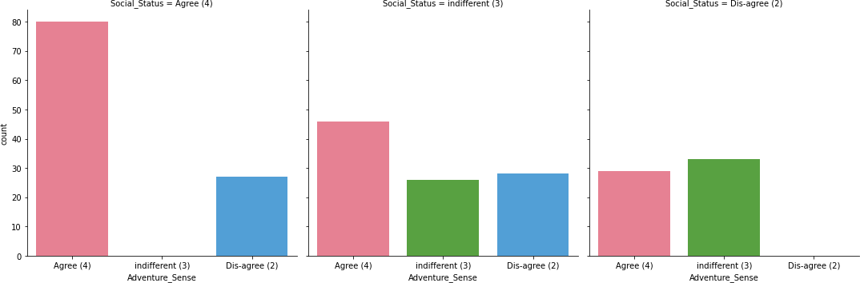

Slide 20
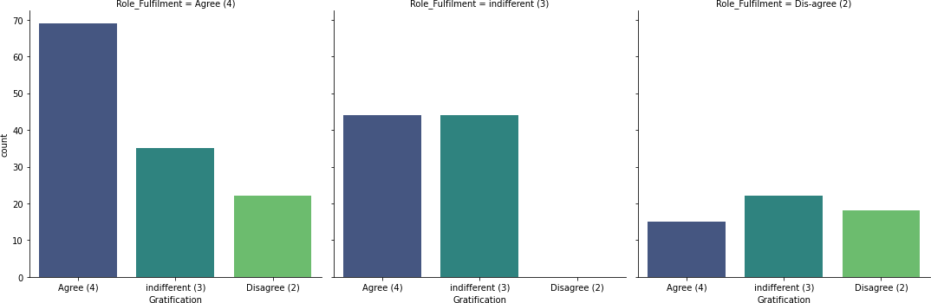

Slide 21
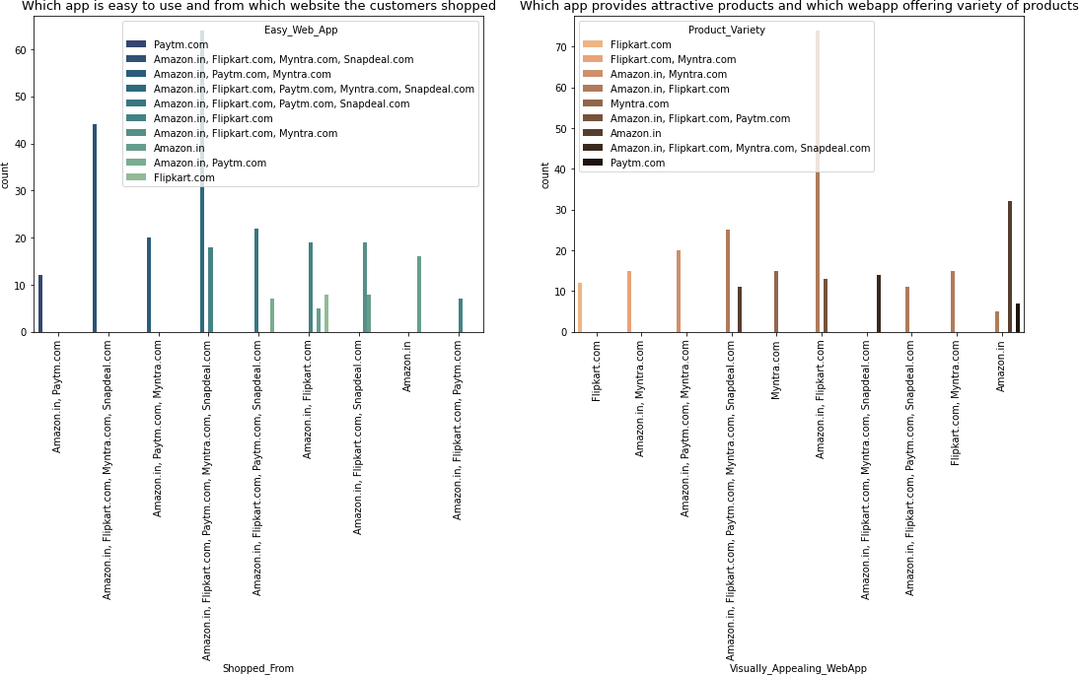

Slide 22
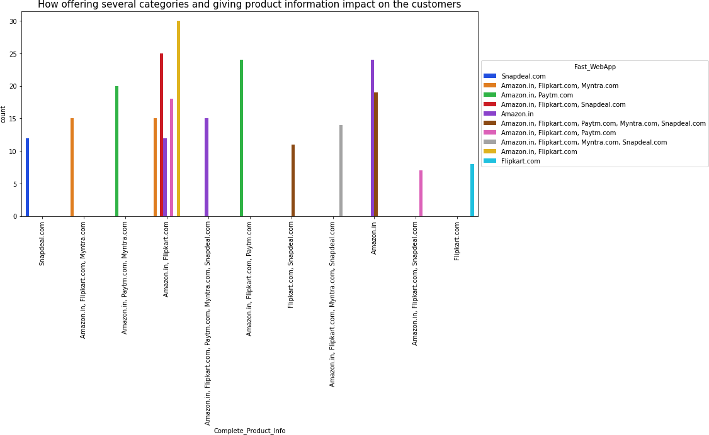

Slide 23
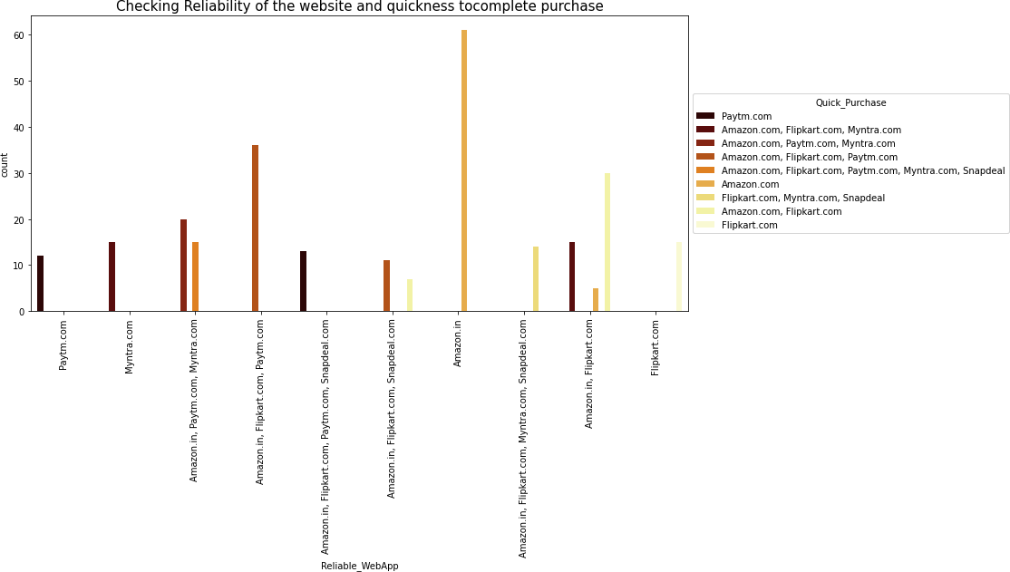

Slide 24
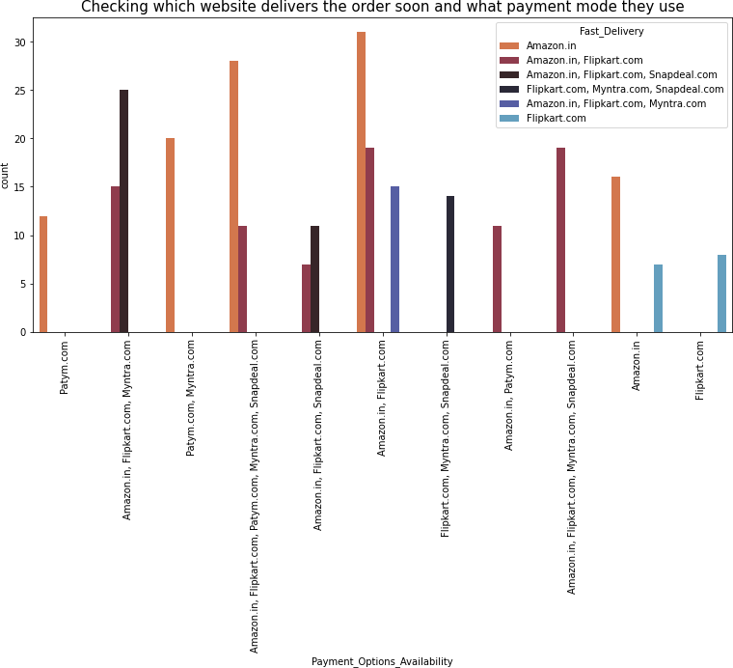

Slide 25
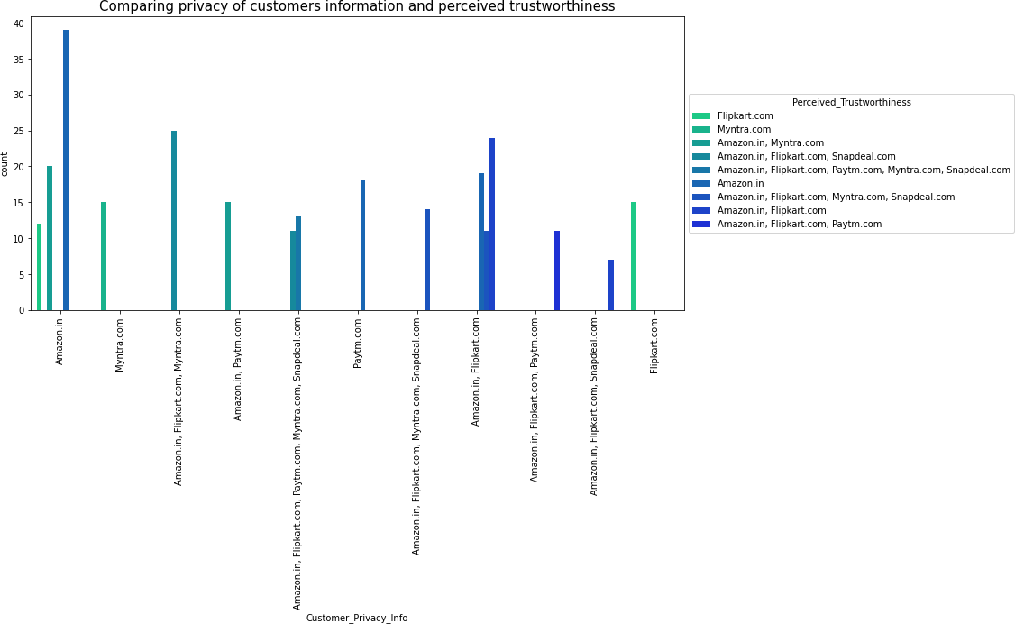

Slide 26
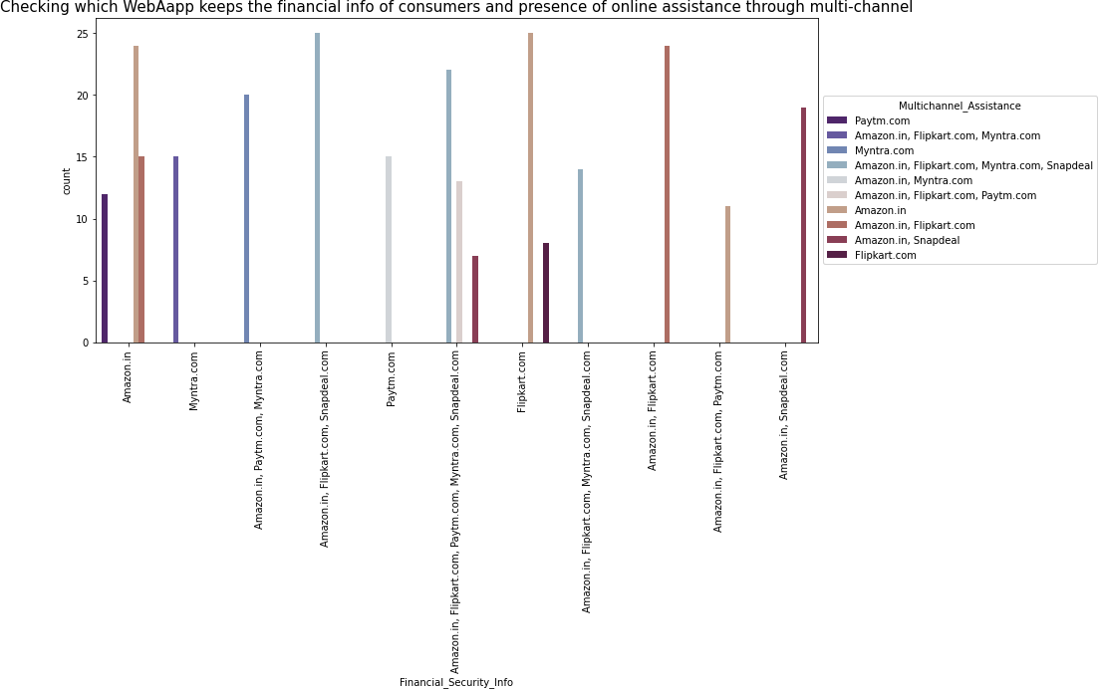

Slide 27
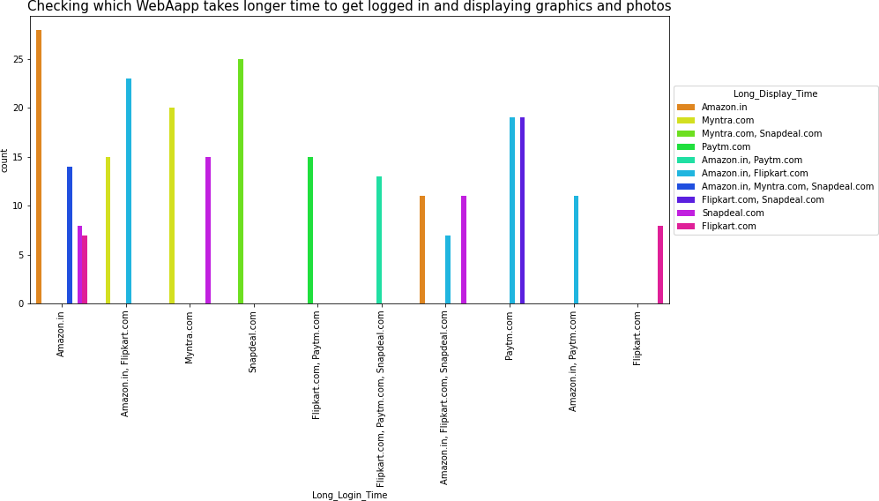

Slide 28
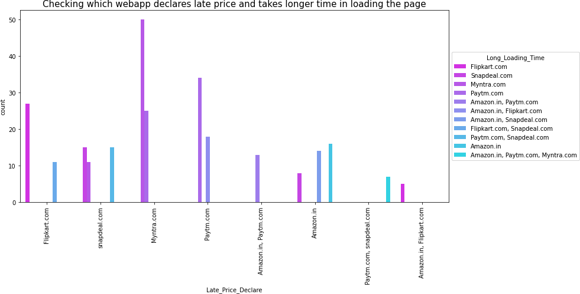

Slide 29
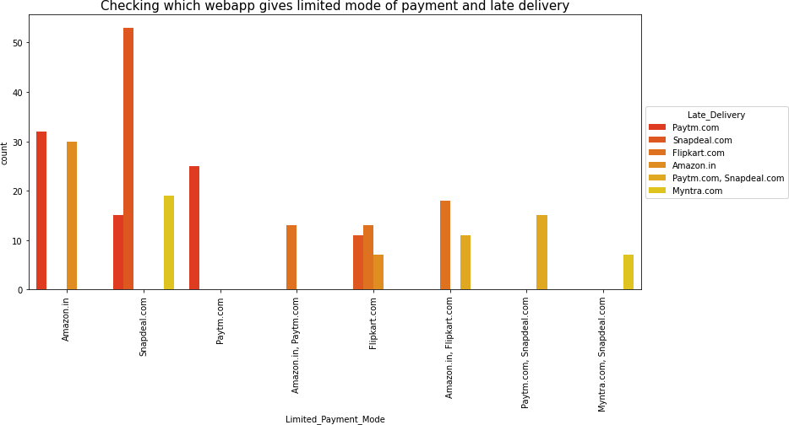

Slide 30
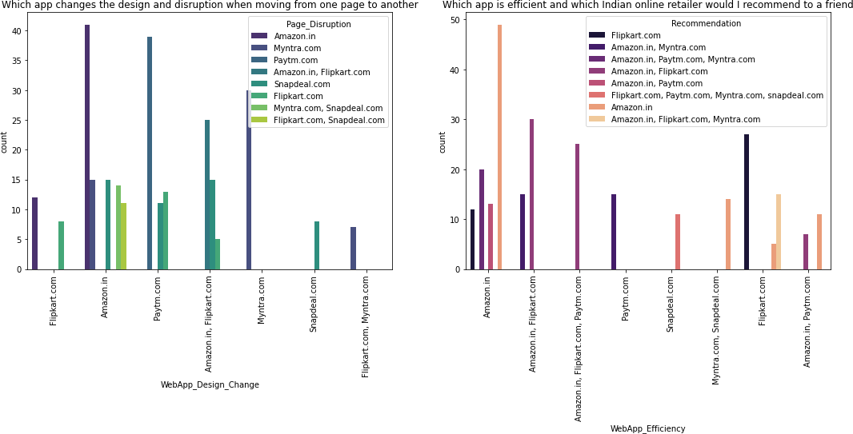
+

Slide 31
Inference
Based on overall observations the first 47 features provide insights on how e-retail is helpful and growing based on customer inputs. The data explained how the online platform has been used more often in which CITY, PIN CODE, AGE etc. It also showed us that in some factors there is less importance given to contribute to the success of an e-commerce store, so based on that we could remove those factors and keep all the important factors. Also we could improve on some factors that influence the online customers repeat purchase intention.
Apart from the first 47 features the rest of the features showed which online platform has been used more based on the success factors. Based on the case study for customer activation and retention, Amazon is the most reliable and has been fulfilled all the customer requirements. After Amazon the data showed Flipkart has been used more for online shopping.
The case study from Indian e-commerce customers showed Amazon and Flipkart has been used mostly for Online Shopping and most recommended by Friends. So based on the research factors Amazon and Flipkart are the e-commerce platform which are having the combination of both utilitarian and hedonistic values to keep the repeat purchase intention (loyalty) positively.

Slide 32
Interpretation of the Results:
The results that were interpreted from the visualization are as follows:
From the survey we found that the customers agreed with certain things like ecommerce websites have empathy towards them, content must be easy to read and understand, similar products should be highlighted for product comparison, payment convenience, trustworthy and they felt gratified while shopping etc.
The respondents were asked to give ratings and feedback regarding certain statements that may be used to describe their ideal online store.
We have found answers from customers like which websites among listed sites they are familiar with, they find easy to use, reliable, secured, about their delivery, change in web design, etc.
From the visualization we have found Amazon.in was the most used and favorite websites for the customers and Flip Kart was the second favorite webapp while snapdeal.com and Paytm.com were the least used websites by the customers.

Slide 33

1. Amazon.com
To be improved:
1. During promotions, try to give a disturbance free shopping experience to customers.
2. Give more payment options to customers.
3. Try to give price early during promotion.
4. Reduce the delivery time of the products.
Positive feedback summary:
1. Convenient to use and also a good website for shopping.
2. Fast delivery of products.
3. Availability of complete information of the products.
4. Presence of online assistance through multi-channels.
5. Reliable website or app, perceived trustworthiness.
Online Store Company:

Slide 34

2. Flipkart.com
To be improved:
1. During promotions, try to give a disturbance free shopping experience to customers.
2. Give more payment options to customers.
3. Try to give the price early during promotion.
4. Reduce the delivery time of the products.
5. Flipkart and Amazon almost share the same feedbacks with varying percentages as the only difference.
Positive feedback summary:
1. Convenient to use and also a good website for shopping.
2. Fast delivery of products.
3. Availability of complete information of the products.
4. Presence of online assistance through multi-channels.
5. Reliable website or app, perceived trustworthiness.
6. Wild variety of products to offer.
Online Store Company:

Slide 35
3. Myntra.com
To be improved:
1. During promotions, try to give a disturbance free shopping experience to customers.
2. Try to give the price early during promotions.
3. Reduce the delivery time of the products during promotions.
Positive feedback summary:
1. Convenient to use and also a good website.
2. Availability of several payment options.
3. Faster products delivery.
4. Complete information of products available.
5. Reliable website or app, perceived trustworthiness.
6. Wild variety of product to offer
Online Store Company:

Slide 36

4. Paytm.com
To be improved:
1. Reduce the delivery time of the products during promotions.
2. Try to give the price early during promotion.
3. During promotions, try to give a disturbance free shopping experience to customers.
4. Late declaration of price and discounts.
5. Frequent disturbance is occurring while moving from one page to another.
Positive feedback summary:
1. Convenient to use and a good website.
2. Quickness to complete a purchase.
3. About 64% of the customers feel that either web or app is reliable.
4. Around 20% of the customers believe that Paytm has a wild variety of products on offer.
Online Store Company:

Slide 37
5. Snapdeal.com
To be improved:
1. Reduce the delivery time of the products during promotions.
2. Try to give the price early during promotion.
3. During promotions, try to give a disturbance free shopping experience to customers.
4. Late declaration of price and discounts.
5. No one has expressed to recommend Snapdeal to a contact as it has the most negative feedbacks among all other websites.
Positive feedback summary:
1. Convenient to use.
2. 54% of the customers are happy about the availability of financial information security.
Online Store Company:

Slide 38
Future Work
I will need to perform some preprocessing on the data for example using the scaling techniques
Since I have mostly categorical data present in the dataset I am not going to worry about removing outliers or skewness
Need to build some unsupervised machine learning models
Will have to verify the clustering or association algorithm details that can be used on the dataset
Some algorithms that I intend to work upon are k-means clustering, k-nearest neighbors for unsupervised machine learning, hierarchal clustering, apriori algorithm and neural networks.

Slide 39
FINDINGS AND ANALYSIS
1) In this project, we have investigated ecommerce quality in online businesses and develop new knowledge to understand the most important dimensions of e-retail factor for customer activation and retention.
2) This project aimed to enhance prior understanding of how ecommerce websites affects customers satisfaction, customer trust, and customer behaviour,i.e, repurchase intention, customer loyalty and site revisit.
3) The dimensions like information about the products, convinient payment mode,trust, fulfilment, website design change,security/privacy and many others had a positive impact on the ecommerce websites for customers. Also, some of the features like ease of navigation, loading and speed , late delivery etc, did not have impact on the ecommerce websites.
4) Thus, a company needs to pay attention to these features more specifically and seek breakthroughs that can improve its performance and e-service quality.
5) Customer satisfaction and customer trust appeared as the outcomes of overall e-retail factor. The reults of the analyis shoes that e-retail factor had a positive impact on customer satisfaction. The majority of research done about e-retail factor states that customer satisfaction is the main determinant impacting on e-retail factor.It supports the idea that there is a significant relationship between e-retail factor and customer satisfaction. E-retail factor also had a positive impact on customer trust.The better the retail factor of a company, the higher the customer trust. Providing good service quality enhances customer satisfaction and customer trust.
6) From the above analysis, it is found that the main reason or factors which attracts customers to do online shopping and the main reasons or obstacles which discourage consumers from shopping online. Therefore, from the analysis, it is found that most of the respondents use internet daily but most of the respondents do not use internet daily to buy products. Nearly half of the total respondents opinions were that they would only use the internet to buy products when the need arises to do so.

Slide 40
ASSUMPTIONS
Based upon the findings and analysis, the following assumptions are presented for the online sellers to make online shopping more popular, convenient, reliable and trustworthy.
1) Transaction security and consumers data safety are principal concerns of online customers purchasing products or services online. Therefore online vendors can assure their consumers' by offering personal information privacy, protection policy and guarantee for transaction security by improving their technological systems.
2) Retailers should be careful about the annoying factors of online shopping such as being unable to access the website, long delays in completing online orders, inconsistencies in the items available online, mistakes in filling orders, and the hassle of returning goods.
3) Online sellers can be more concerned about delivery times, delivery charge and product return policies. They can make it easier, quicker and reliable, so that consumers can enjoy the online shopping experience and they likes ti shop in the particular websites regularly.
4) The respondents thought that products' mixing up or they find different product at delivery time which is the main inhibition of online shopping, so that the sellers must be very cautious when it comes to delivery.
5) Getting feedbacks from the customers is also on of the important thing to improve the sales of the company. The e-tailer wants to keep the customer happy in order to build the successful business, but they easily fall into a trap of assuming that the customers will give feedback without being prompted. If the e-tailers are doing something wrong, most of the customers won’t complain, they will just go elsewhere. So it is important to ask customers how they really feel about their services.

Slide 41
CONCLUSIONS
1) The endeavour of this study is to identify the motivating factors towards online shopping and in which e-retailer the customers likely to shop more.
2) In this project, I have done some feature engineering by replacing the unwanted entries by suitable columns, found no null values, and renamed the columns by giving new names. Visualized the data using count plot, factor plot, pie plot and distribution plot, also encoded the object data into numerical using label encoding method. Checked the statistical summary of the dataset and checked for skewness, outliers and correlation between the features.
3) From the analysis it was found that consumers purchasing decisions were dependent on various factors. All these motives motivate consumers to purchase products through online. According to consumers' opinions, "time saving" is the most important motivating factor for online shopping.
4) Again "information availability", "open 24/7", "huge range of products/ brands", "reasonable prices", "various offers for online products", "easy ordering system", and "shopping fun" are other motivating factors for online shopping respectively. Also, "online payment system", "personal privacy or security issues", "delaying of delivery" and "lacks of personal customer service" are the main inhibitions of online shopping to the respondents.
5) After visualizing the data, I found Amazon is the best online store where the customers trust on buying products and it has positive impact on the customers. Also, amazon and flip kart have increased customers’ expectations. So, they are the best online retailer who makes the loyal customers and satisfies the customers.
6) It was also observed that online shopping is not trustworthy and reliable to some consumers due to only online payment system and personal privacy. In addition, online security is a major concern for the consumer particularly in terms of fraud, privacy and hacking. So, the organizers should make up their organization for better sales

Slide 42


